Slide 1

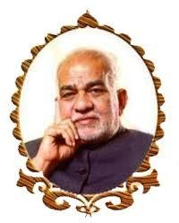
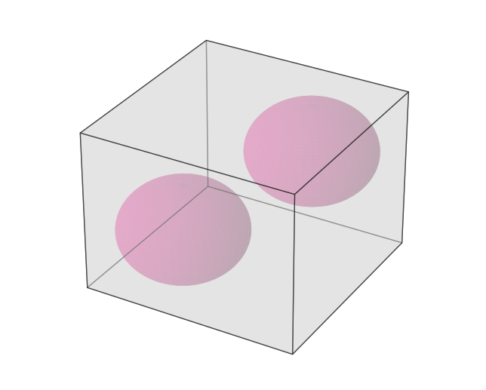
BVRIT HYDERABAD College of Engineering for Women
Department of Computer Science and Engineering
BALLOONS IN A BOX
Guided by: V.Indu
Team No: 3
KPM SRI MANASWI (21WH1A0575)
B HEMALATHA (21WH1A0576)
CH SRI VRINDA (21WH1A0577)
P LIKHITA VARMA (21WH1A0578)
ANIYA AFNAN (21WH1A0579)

Slide 2
AGENDA
Problem Statement
Modules and Python Packages
Contribution of team
Learning and Challenges Faced
Execution of final code
References (links, tutorials)

Slide 3
Problem Statement
You are given a rectangular box and a set of points.
Each point represents a position where you might place a balloon.
Center it at the point and inflate the balloon until it touches a side of the box or a previously placed balloon
The objective is to place balloons in the box in an order
that maximizes the total volume occupied by the balloons.
You are required to calculate the volume within the box that
is not enclosed by the balloons.

Slide 4
Modules and Packages
Packages | Modules
Matplotlib | Matplotlib.pyplot Mpl_toolkits.mplot3d.art3d Poly3DCollection
Tkinter | NumPy
Playsound | Playsound
Pygame | Math, Itertools
10-03-2023
Department of Computer Science and Engineering

Slide 5
Contribution of Team
Roll Number | Name | Contribution
21WH1A0575 | KPM Sri Manaswi | get_max_volume function using itertools , Creating GUI windows, Linking tkinter files, 3D Simulation, 2D Simulation, Splash Screen window using tkinter, Radius_dict, playsound
21WH1A0577 | Ch Sri Vrinda | Overlapping condition for special cases, Creating GUI windows, Linking tkinter files, 3D Simulation, 2D Simulation, playsound, Simulate_points, GUI exception handling
21WH1A0578 | P Likhita Varma | Calculate_volume function, place_balloon function, Creating GUI windows, Linking tkinter files, Linking Python files, 3D Simulation, 2D Simulation, Inputs and Output GUI interface, Adding music using pygame.
21WH1A0579 | Aniya Afnan | Input GUI buttons, Adding sounds to buttons, GUI backgrounds
21WH1A0576 | Hemalatha | Welcome screen, Information gathering, color codes
5

Slide 6
Learnings and Challenges
Calculating the combination of spheres which would take up the maximum volume
Checking the overlapping condition of spheres while calculating volume
3D simulation of spheres and their expansion inside cuboid
Linking matplotlib 3D simulation into Tkinter input window
Linking two python files
10-03-2023
Department of Computer Science and Engineering

Slide 7
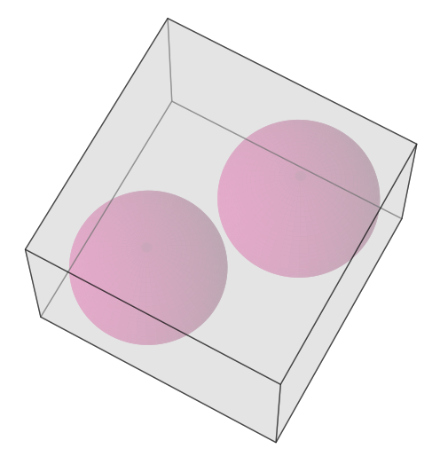
Execution of final code

Slide 8
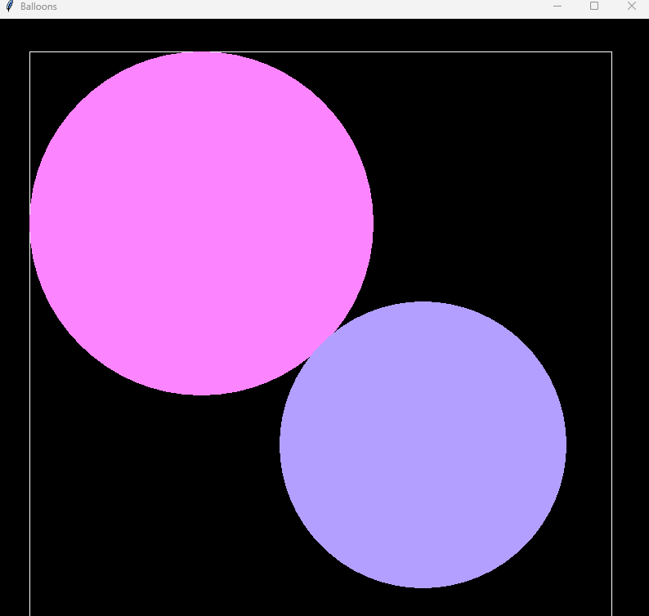
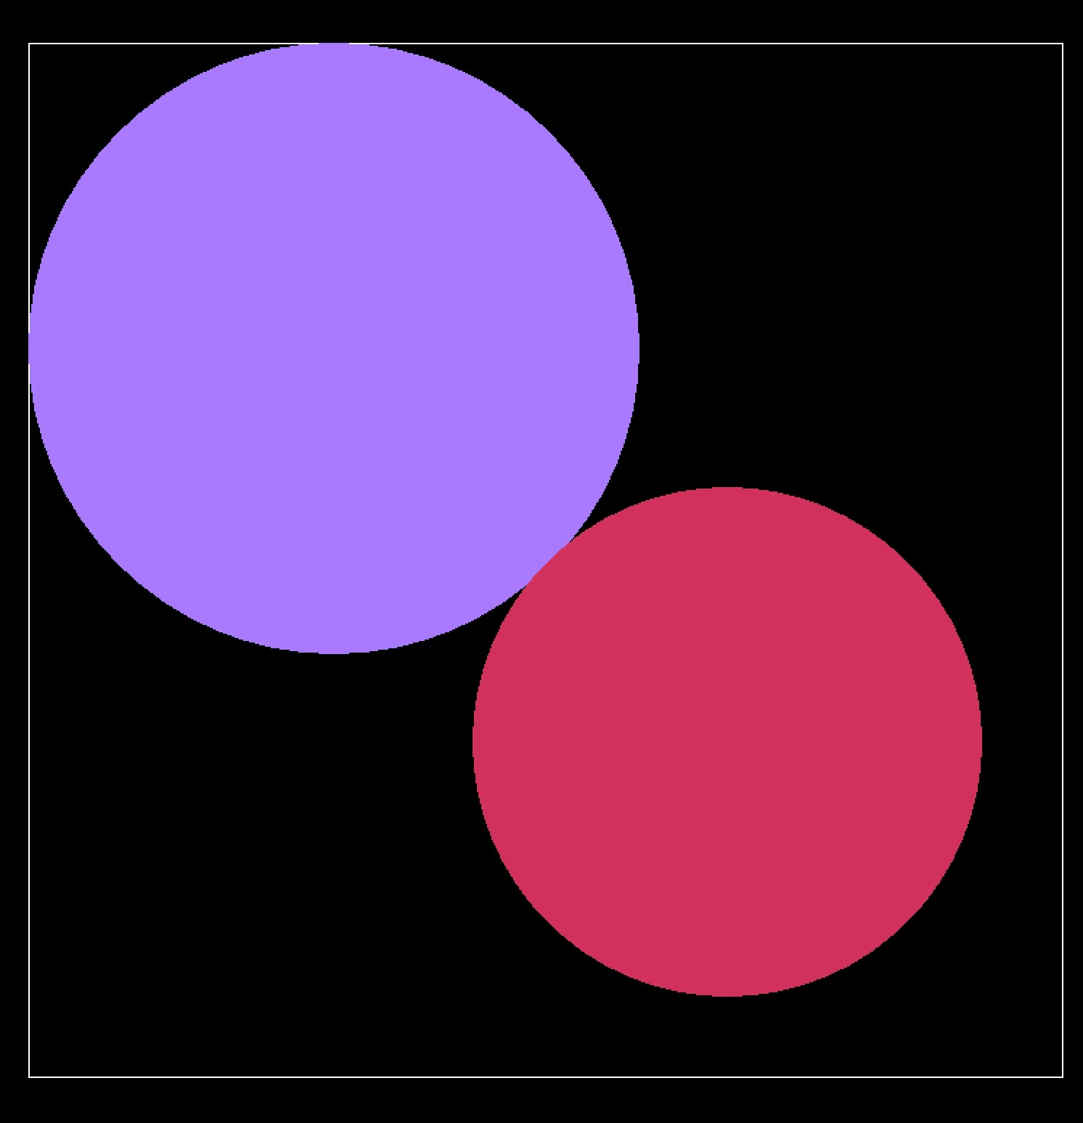
10-03-2023 Department of Computer Science and Engineering

Slide 9
References
https://youtu.be/JrrfeOi-Ep0
https://www.youtube.com/watch?v=YXPyB4XeYLA
https://stackoverflow.com/questions/70443422/good-looking-sphere-in-matplotlib
https://stackoverflow.com/questions/63922028/how-to-pause-matplotlib-animation-for-some-secondswithout-using-any-mouse-click

Slide 10
THANK YOU

